Slide 1
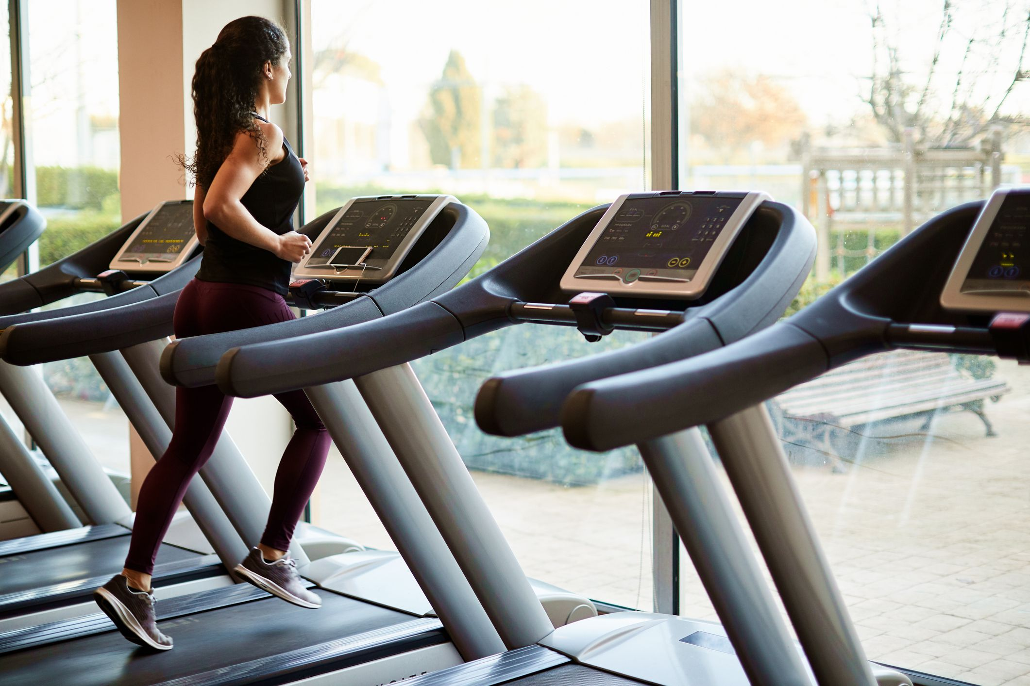
TreadMILL DASHBOARD
GP 106 PROJECT
2021
GROUP 128

Slide 2
GROUP MEMEBERS
W.K.H.M. WEERASINGHA - E/18/383
G.M.R.R. WEERASINGHE - E/18/384
I.D. WEERASINGHE - E/18/385
FACULTY OF ENGINEERING
UNIVERSITY OF PERADENIYA

Slide 3
INTRODUCTION
Exercise is an essential fact for a human life style.
Treadmill is an one of the best exercise machine which is very famous among people
Parameters which are related to health of a human are calculated and displayed
Project is implemented by python

Slide 4
OUR GOALS
Create a basic operate system for a treadmill
Improve current system until a real time treadmill
Design an UI for inputs and get outputs
Identify hidden talents in team members

Slide 5
USED LIBRARIES
Date time
Time
tkcalendar
tkinter
PIL
math

Slide 6
PROJECT STRUCTURE
Project
MS1
Bonus
MS2

Slide 7
MILESTONE 1
All the calculations are under a selected time
System inputs
Motor rpm
Shaft radius
Height of the person
Weight of the person
Time
Parameters is calculated for a basic system,
Burnt calories
Walked distance
Treadmill speed
steps

Slide 8
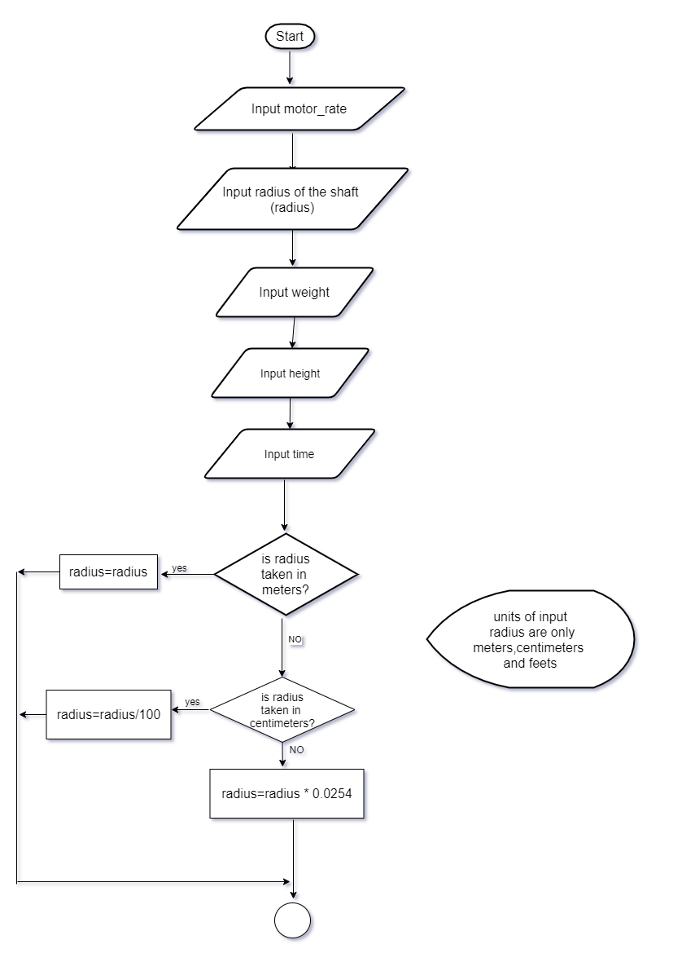
FLOW CHART MILESTONE1

Slide 9
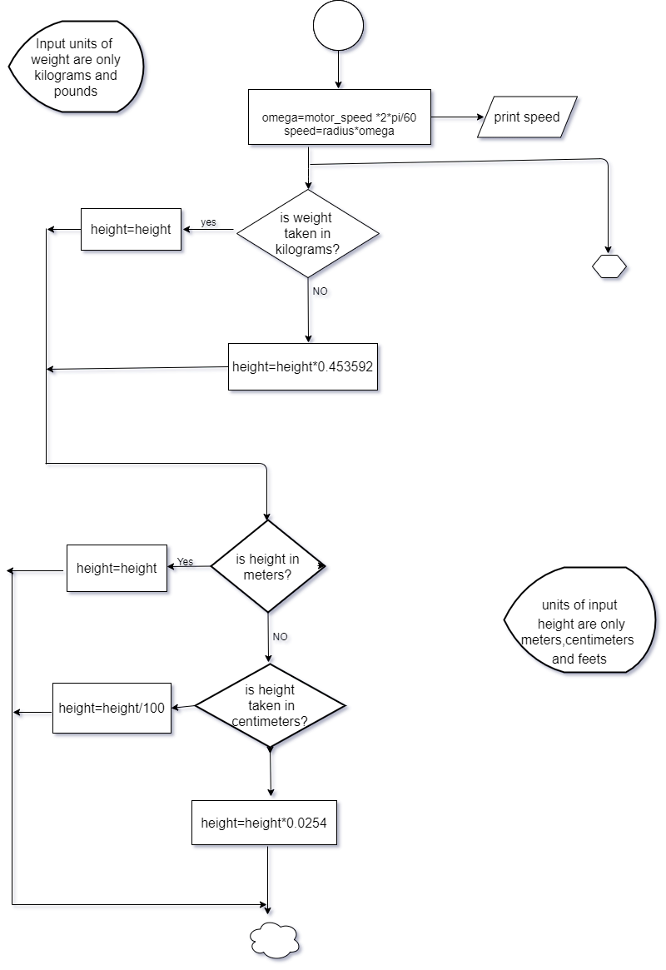

Slide 10
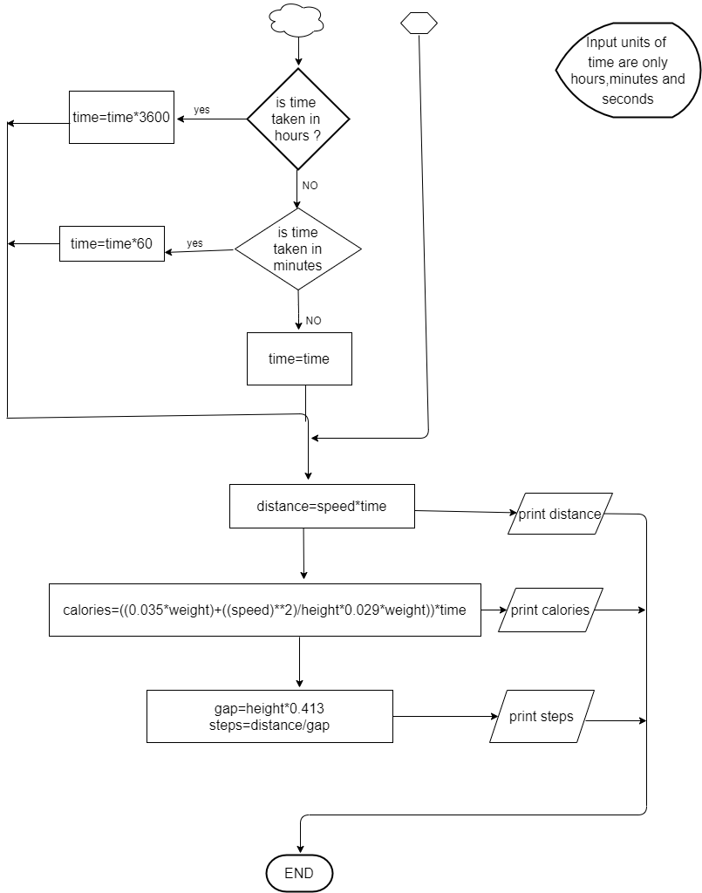

Slide 11
MILESTONE 2
System is converted in to a real time program.
System inputs are same with milestone 1 except time.
Output parameters are same with milestone 1.
Outputs are displayed in python IDLE.

Slide 12
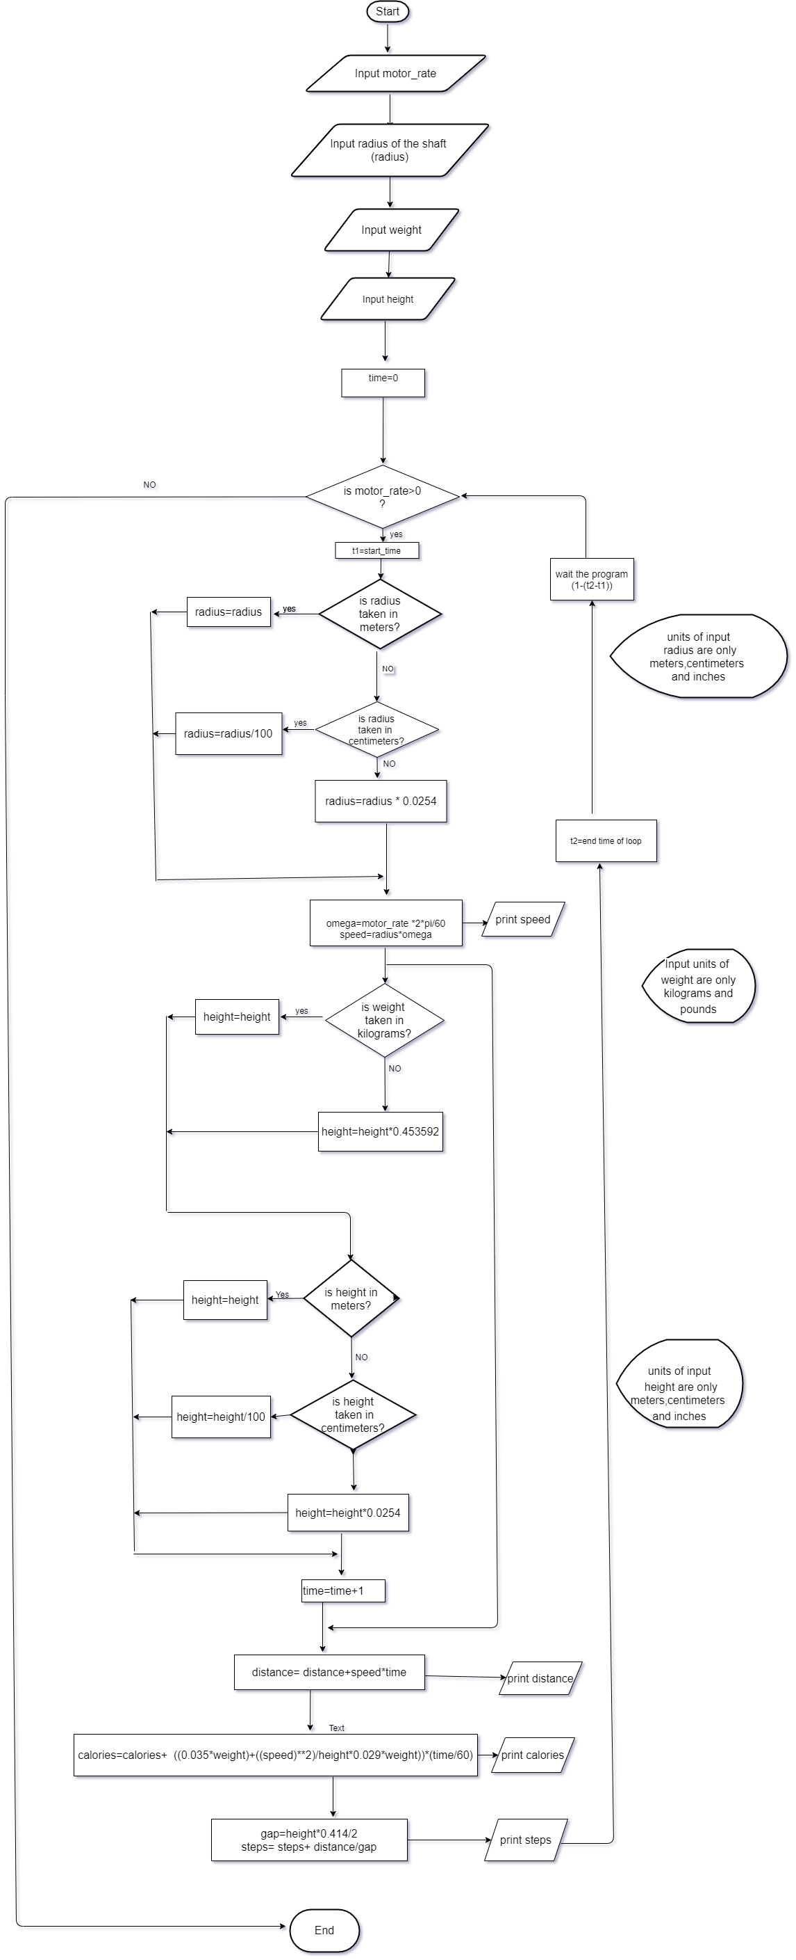
FLOW CHART MILESTONE2

Slide 13
DIFFICULTIES AND SOLUTIONS OF MS2
DIFFICULTY
Display both previous and current calculated parameters
SOLUTION
OS library was imported
Code was run using command prompt
Only current parameters were displayed

Slide 14
BONUS
GUI is designed to display outputs.
Opportunities for user,
Ability to change the treadmill speed.
Can see updated walking steps and burning calories.
A calendar gives the usage of treadmill for a considerable day.

Slide 15
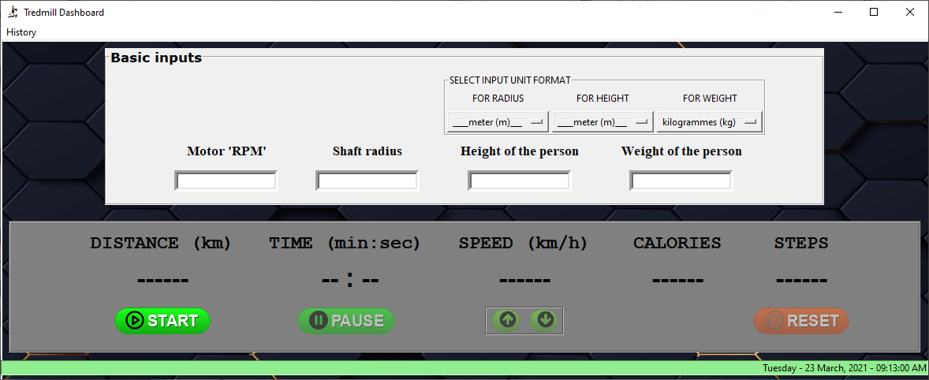
GUI

Slide 16
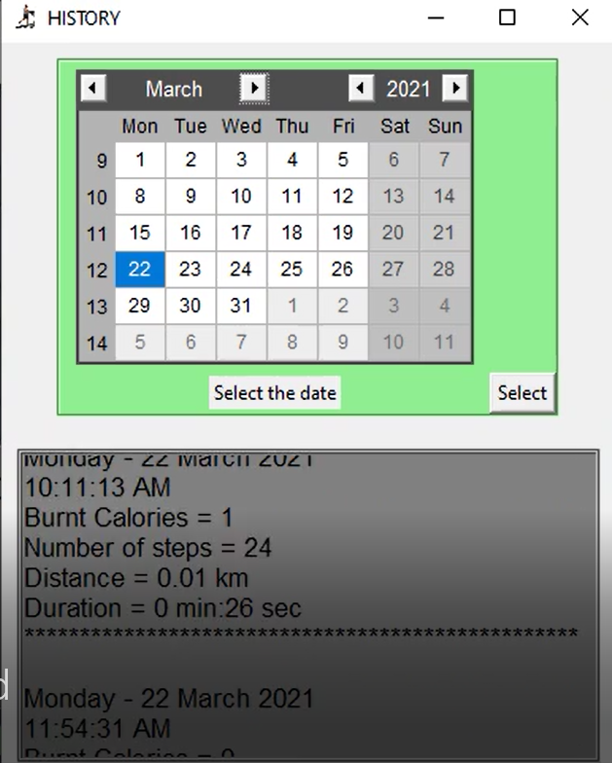
DATA CALENDAR

Slide 17
REFERENCES
Links for equations
https://www.google.com/amp/s/www.womanandhome.com/amp/health-and-wellbeing/calories-burned-walking-206766/
https://www.verywellfit.com/set-pedometer-better-accuracy-3432895
https://www.livestrong.com/article/34973-calculate-treadmill-calories/
Link how project was designed using real time method
https://www.programiz.com/python-programming/datetime/strftime
How we learnt on tkinter for designing a GUI
https://youtube.com/playlist?list=PLCC34OHNcOtoC6GglhF3ncJ5rLwQrLGnV
Links how the buttons in GUI was added
http://buttonoptimizer.com
Reference for color codes
https://htmlcolorcodes.com

Slide 18
PROBLEMS WE FACED
Creating a GUI was failed in so many times.
It was difficult to run infinite loops
Default buttons in GUI was not userfriendly.
Many functions were used to increase and decrease the speed of Treadmill

Slide 19
HOW WE OVERCOME THEM
Found web sites which were included proper methods to create a GUI.
Function in functions were run in the program with a delay time.
Top Treadmill icon was designed using illustrator

Slide 20
ANY QUESTIONS?

